Slide 1

Identifying Sales Trends in International Bike Sales and their Health Implications

Slide 2
Background and Motivation
Obesity is an important issue worldwide which causes a lot of deaths.
More than 2 in 5 adults in the world (42.4%) have obesity (including severe obesity).
Europe has 53% overweight adults and 17% obese adults.
Cycling is a good way to control or reduce weight
The health benefits of regular cycling include increased cardiovascular fitness, muscle strength and flexibility.
Also beneficial for the environment.
Choosing a bike over a car just once a day reduces the average person's carbon emissions from transportation by 67%.
We want to analyze bike sales across the United States and Europe to determine which US State and European Country, gender, and age group buys more bikes
We can draw conclusions on the data and see if in those countries obesity rates are lower and if there are less carbon emissions.

Slide 3

Objectives
How have the demographics of bike sales changed over time?
Which geographic locations have the most sales?
What age group make up most of the bike sales?
How are the sales volumes split between males and females?
How is the profit split across countries and the sub-categories of complimentary goods for bikes?
What is the yearly profit by country for bike sales?
Which sub-category of complimentary goods for bikes made the most profit in sales?
How do sales compare across countries?
What are the overall benefits and safety risks of using a bike?
Are bike sales and uses correlated to obesity trends?
Bike accidents vs Vehicle accidents? Which is safer to use?
How is the emissions rate compared to bike sales?

Slide 4

Data Source and Variables
We will study the of issue Sales Trends in International Bicycle Sales and their correlation to Obesity Rates, Carbon Emissions, and Safety Issues using publicly available data collected from Kaggle.com, the World Health Organization, Harvard School of Public Health website, and The World Bank websites. We will utilize data sets from Kaggle and The World Bank, as well as articles from the World Health Organization and Harvard School of Public Health that pertain to health and environmental benefits related to bicycles, as well as statistics of obesity and safety concerns. Our goal is to correlate the data from these sources to describe the issue of Sales Trends in International Bicycle Sales and their correlation to Obesity Rates, Carbon Emissions, and Safety Issues.
https://www.kaggle.com/datasets/sadiqshah/bike-sales-in-europe/
https://data.worldbank.org/
https://www.kaggle.com/code/khsamaha/eda-bicycle-accidents-gb-1979-2018-r
https://www.kaggle.com/datasets/silicon99/dft-accident-data
https://www.worldometers.info/co2-emissions/co2-emissions-by-country/

Slide 5
Data Source and Variables (cont.)
By analyzing the data from these sources, we plan to employ the below variables in our study.
Country of bike sales, obesity rate, carbon emissions, and safety statistics: categorical variable.
Date of bike sales, obesity rate, carbon emissions, and safety statistics: categorical variable.
Age group of bike sales: categorical variable.
Obesity rate: quantitative variable.
Safety statistics: quantitative variable.
References
https://www.who.int/director-general/speeches/detail/who-director-general-addresses-road-safety-conference
https://www.who.int/news-room/feature-stories/detail/healthy-and-sustainable-transport
https://www.who.int/director-general/speeches/detail/who-director-general-addresses-road-safety-conference
https://ecf.com/news-and-events/news/how-much-co2-does-cycling-really-save#:~:text=Add%20to%20that%20the%20CO2,times%20less%20than%20a%20car!

Slide 6
How have the demographics of bike sales changed over time?

Slide 7
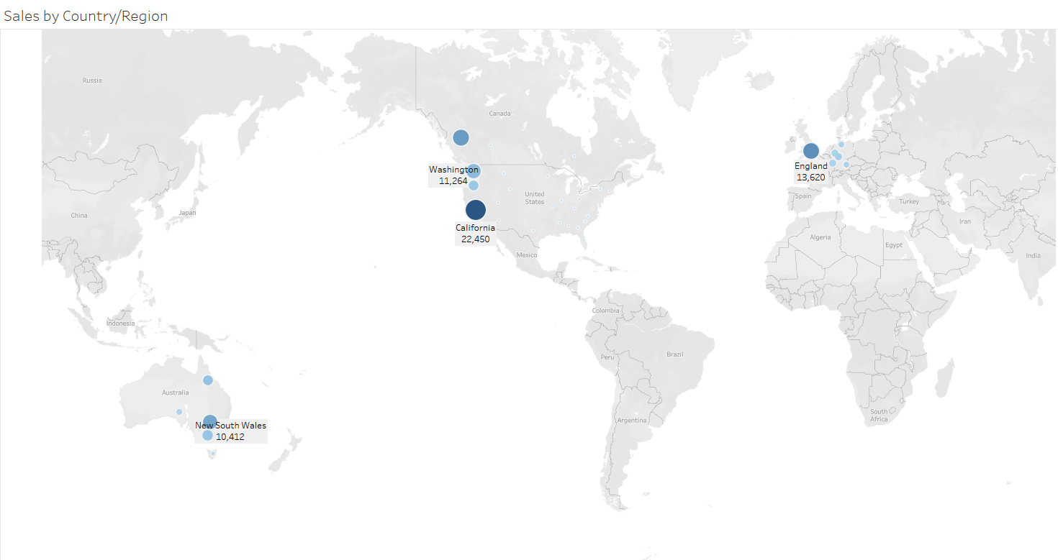
Which geographic locations have the most sales?

Slide 8
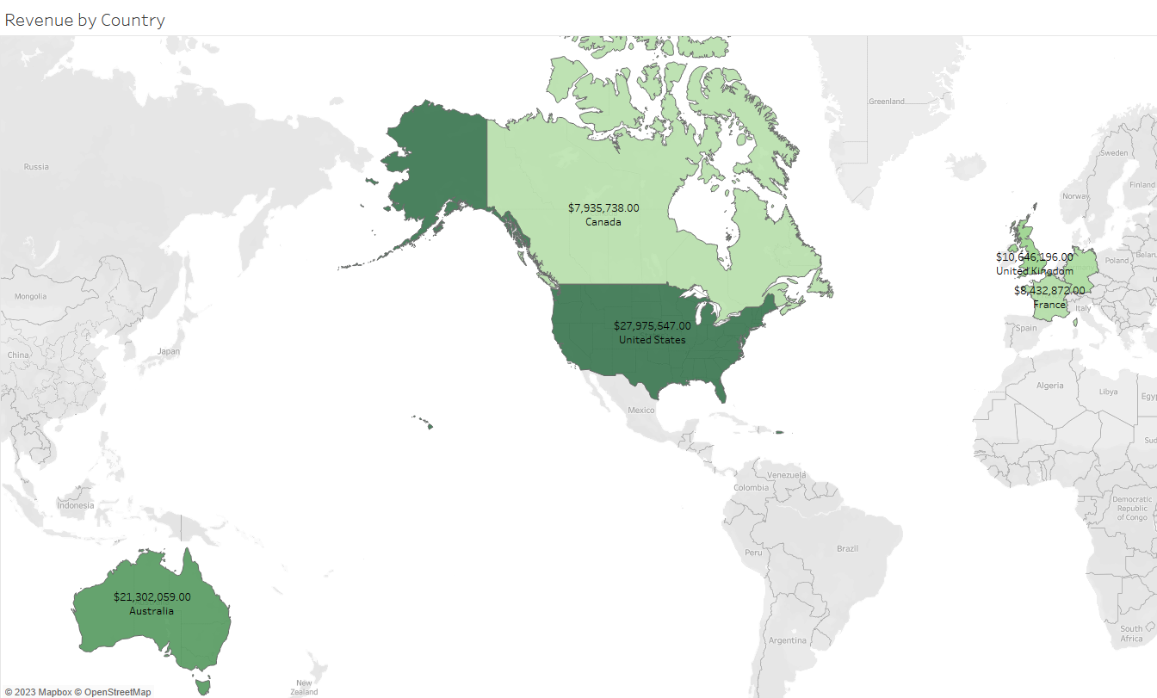

Slide 9
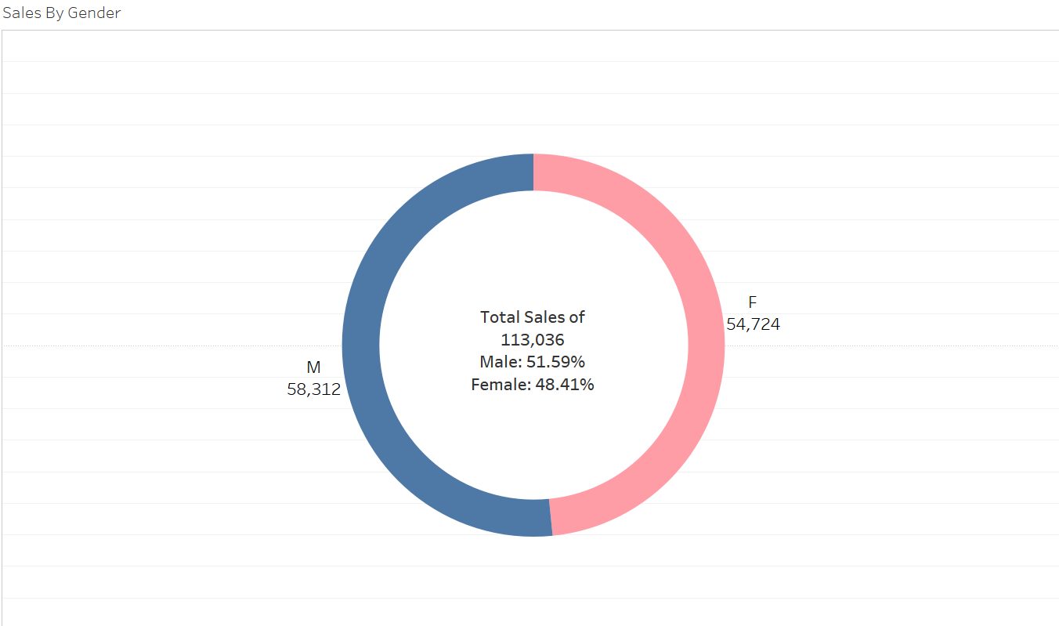
How are the sales volumes split between males and females?

Slide 10
How is the profit split across countries and the sub-categories of complimentary goods for bike?

Slide 11
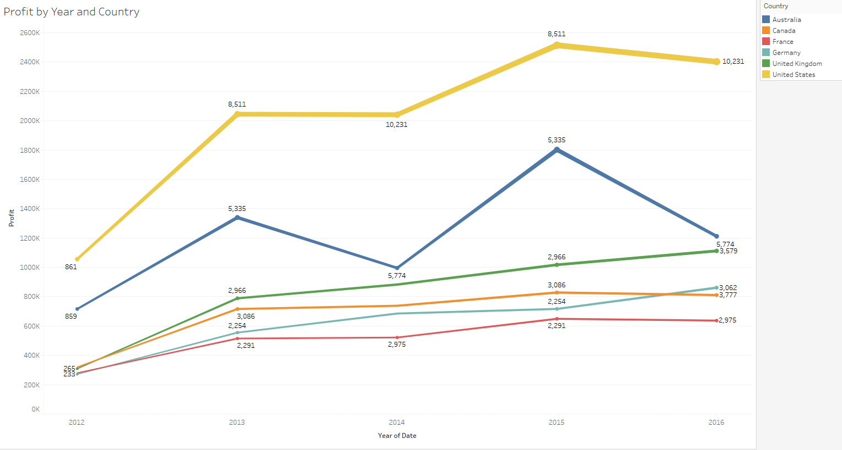
What is the yearly profit by country for bike sales?

Slide 12
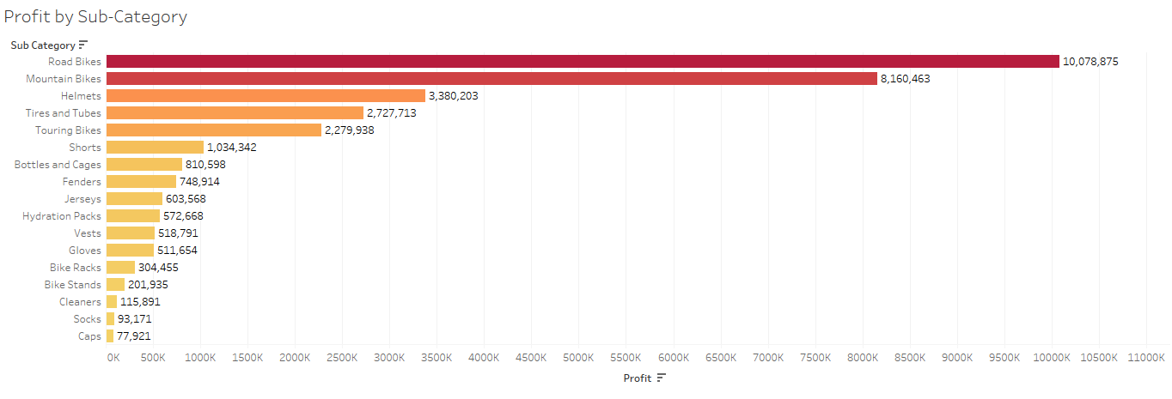
Which sub-category of complimentary goods for bikes made the most profit in sales?

Slide 13
What are the overall benefits and safety risks of using a bike?

Slide 14
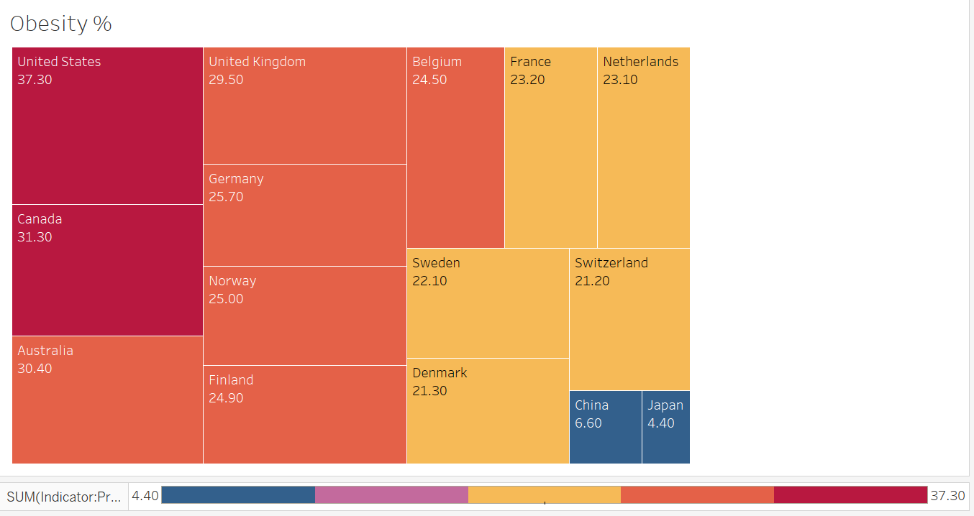
Are bike sales and uses correlated to obesity trends?

Slide 15
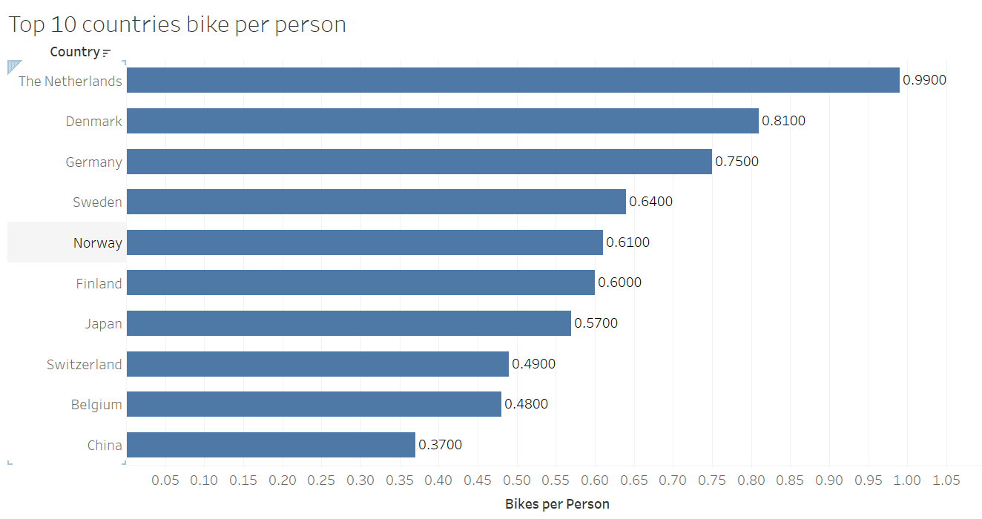

Slide 16
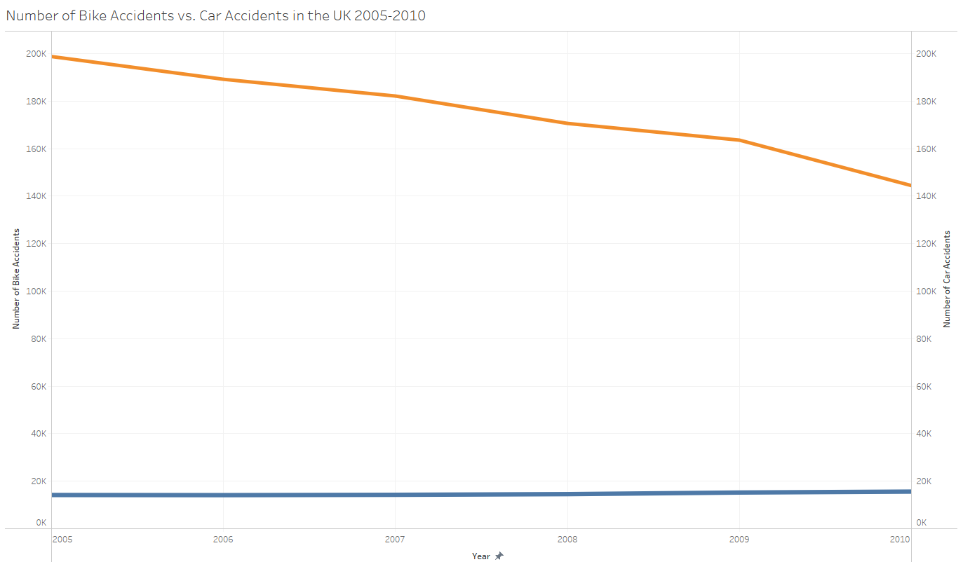
Bike accidents vs Vehicle accidents? Which is safer to use?

Slide 17
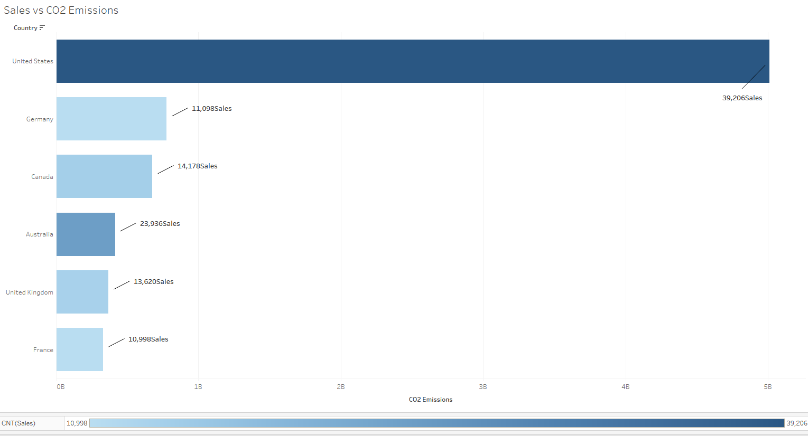
How is the emissions rate compared to bike sales?

Slide 18
Key Takeaways
The United States has the highest revenue, profit, and number of bike sales across the observed countries.
After the United States, Australia, The UK, Germany, France, and Canada follows behind in that order in sales volumes.
Males make up 51.59% and Females make up 48.41% of bike sales. Though males bought more bikes, the split is fairly even.
Road bikes make up the highest amount of profit in the sub-categories.

Slide 19
There has been a steady increase in yearly profits in each country.​
CO2 emissions could decrease if more people switch to bike usage, however other factors need to change to effectively decrease emissions.​
There is a relationship in obesity and bike usage per country. There are lower rates of obesity in countries with higher number of bike usage. ​
Bike deaths are incredibly lower than car deaths, however, more needs to be done for awareness in bike safety. ​

